Slide 1

KONGUNADU COLLEGE OF ENGINEERING AND TECHNOLOGY (AUTONOMOUS) Namakkal - Trichy Main Road, Thottiam-621215 Department Of Computer Science And Engineering FINAL YEAR PROJECT
Class/Academic year : IV/2019-2020
Name of the Guide : Ms.S.Dhivya M.E,
Project Member : J.SUMETHA (621316104053)
C.SINDHUJA (621316104049)
S.KUMUTHA (621316104026)
Title :E-GREENS : A Complete Farmers Solution
Using web Development Under Digital
India Scheme.
Batch No : 18

Slide 2
ABSTRACT
More effective and fast response towards customers needs can be achieved easily through the system without any intermediates.
To implement this online shopping , virtual store on the internet is needed which allows customers to seek for products and select them from a catalogue.
Other modules such as Meteorological Report, Geographical Condition, Fertilizers and Recent Updates are provided.
The entire design is based on React Native platform and Mongo DB databases another programming languages such as Java script, html and Php.

Slide 3
INTRODUCTION
Agriculture plays a very crucial role in our day to day life.
It is well known for us, they strive a lot but in return they are not getting back what they deserve.
So our major focus is about the upliftment of farmers and at the same time the customers i.e, (end users) can have the better solution for the problem i.e,(interms of quality and price).

Slide 4
LITERATURE SURVEY
AUTHOR : Faisal Bin Al Abid, A.N.M Rezaul Karim
TITLE :Cross-Platform Development for an online Food Delivery
Application
YEAR :2017
THEME :Popular use of various mobile operating systems like android and iOS, applications in these sectors are getting more significance than ever. Since each of these platforms requires different types of programming knowledge, developers need to spend much time and cost to build app for separate platforms. So, in order to mitigate these problems, web based solution can be used.

Slide 5
LITERATURE SURVEY
AUTHOR : Alberto Bañacia, Marc Dindo Fernando, Arne Requillo Jr.,
TITLE : Design and Implementation of an Android Application using
WiFi-enabled Devices for the Food Servicing Industry
YEAR :2013
THEME : Food businesses are constantly looking for ways to improve their services, and one approach that consistently delivers value is investing in new technology to do things smarter, faster and more efficient. This study aims to improve this system by developing an android application that hastens customer waitperson interaction in terms of compliance of orders through the use of WiFi technology.

Slide 6
LITERATURE SURVEY
AUTHOR :Sushmita Sarkar, Resham Shinde, Priyanka Thakare
TITLE :Integration of Touch Technology in Restaurants
using Android
YEAR :2014
THEME : This research work aims at improving the quality of services and business of the hospitality industry by incorporating technology. A detailed research on the integration and utilization of technology in hospitality industries showcased that various applications based on wireless technologies are already in use enabling partial automation of the food ordering process.

Slide 7
LITERATURE SURVEY
AUTHOR :Shubham Takalkar,Devendra Phatak, Kumar Abhinav,
TITLE : Android Application for Local Food Ordering
System
YEAR :2016
THEME : The Rampant growth of wireless technology and Mobile devices in this era is creating a great impact on our lives. Some early efforts have been made to combine and utilize both of these technologies in advancement of hospitality industry. This research work aims to automate the food ordering process in near vicinity and also improve the dining experience of customers.

Slide 8
LITERATURE SURVEY
AUTHOR :Akash Patil, Rinkesh Kalani,Bhavesh Patil,Sachin
Shinde
TITLE :SMART RESTAURANT SYSTEM USING ANDROID
YEAR :2013
THEME : In most of the restaurants meal ordering is relying on the interaction with waiters to place order into the kitchen. In busy hours of restaurant this coordination is a challenge result in un-satisfaction to the customer. To realize this, Smart Restaurant System is designed.

Slide 9
EXISTING SYSTEM
This system facilitates the farmers to sell their crops through an online payment.
Apart from which additional government schemes and their related information would be displayed on the website.
A complete focus on the manure, Geographical, Meteorological conditions are provided through which they can overcome the major problems that they are facing in their day to day life.

Slide 10
DISADVANTAGES
This system focus only on the Trade-Off(Sales)part.
The price amount are based upon the updates of farmers done and not as per government fixed scale.
No additional details regarding the farming such as loans, various materials such as fruits and other data are not mentioned.

Slide 11
PROPOSED SYSTEM
React native is the platform that we are working for the development of website.
In addition with it Page Ranking and Encryption Algorithm are the two algorithms that are been used.
PHP, HTML, Mangodb are the languages which supports for our development.
This system provides entire solution for farmers by focusing on their major issues.

Slide 12
ADVANTAGES
Farmers and End users(customers) can be benefited.
Non-Payable system that gives the most valuable information of farming and sales part are provided.
The better the type of manure added the better they yield their crops(Manure type depending upon the soil and crop variety are given).

Slide 13
REQUIREMENTS
HARDWARE REQUIREMENTS:
PROCESSOR : i5
Hard Disk : 512 GB
Ram : 4 GB
SOFTWARE REQUIREMENTS:
Operating system : Windows 10

Slide 14
ALGORITHM
Encryption Algorithm
Page Ranking Algorithm

Slide 15
ENCRYPTION ALGORITHM
Encryption algorithmic rule may be a mathematical procedure for performing encryption on data.
With the use of this algorithm plain text is converted into meaningless cipher text and using key values it will again convert to its original text format.

Slide 16
PAGE RANKING ALGORITHM
To rank the online pages in efficient manner Page Ranking algorithm is used.
A Page Rank results from a mathematical algorithm supported by the online graph.
Value of the particular page is specifies as a rank value.
Scores are determined by the number of other Web pages that link to the target page.
Every link is counted as the vote for the target.
Page rank assigns every search results in the rank or score formation.

Slide 17
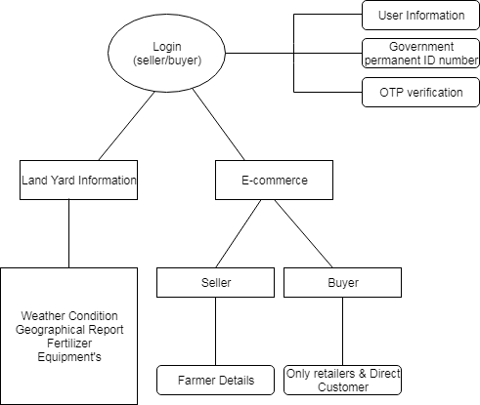
ARCHITECTURE DIAGRAM

Slide 18
MODULES
Meteorological Report
Geological Report
Fertilizers
Recent Updates
Sales

Slide 19
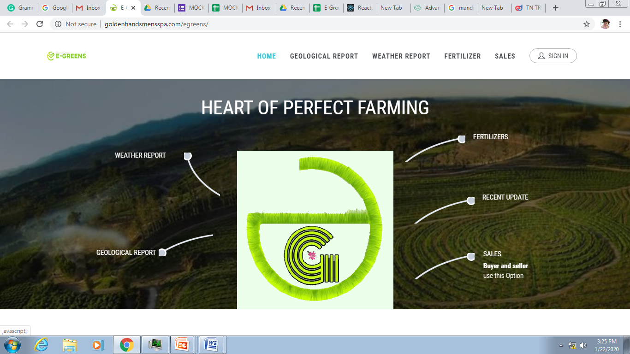
SCREENSHOTS OF PRESENT WORK

Slide 20
METEOROLOGICAL REPORT
Nowadays whether condition is differed mostly compared to the olden days.
In this module user can known about the current whether condition of the place.
The exact satellite view could be obtained.

Slide 21
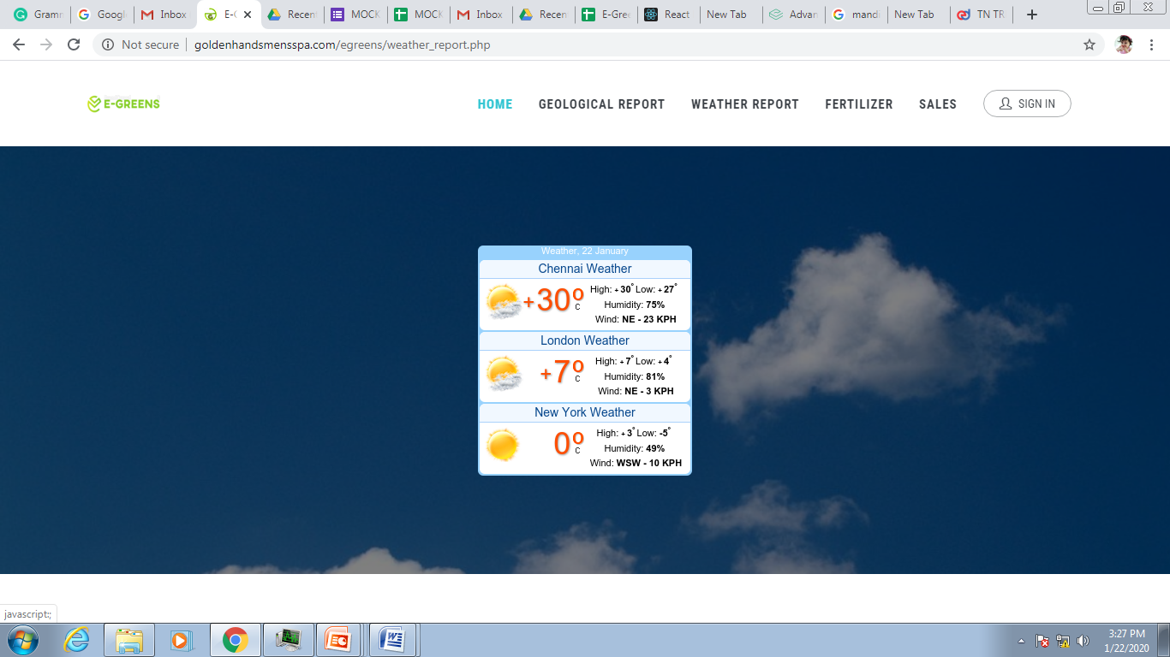
METEOROLOGICAL REPORT

Slide 22
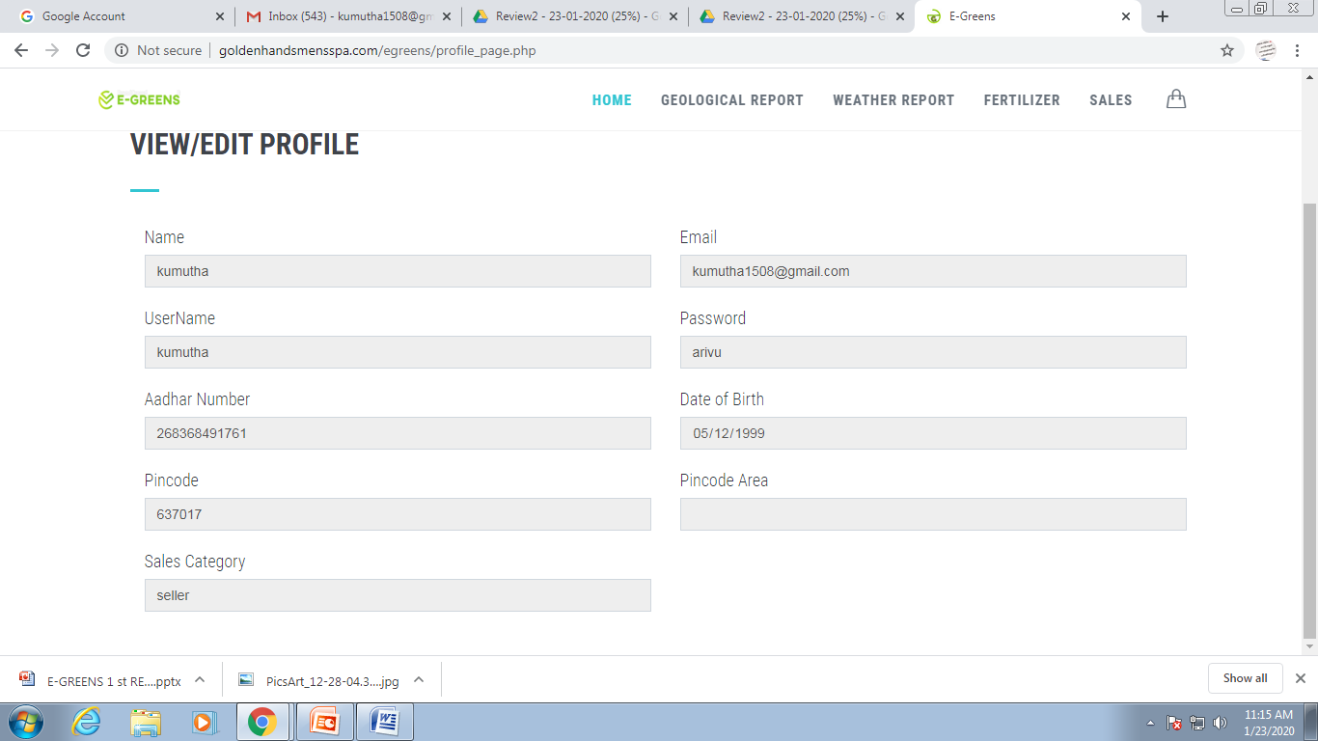
RECENT UPDATES

Slide 23
SALES
In this module user can register their designation as seller or buyer.
In the seller module farmer can fill their details about crops and its quantity with their bank details.
Here, buyer can register their details and buy the things based on their needs through the direct communication with seller.

Slide 24
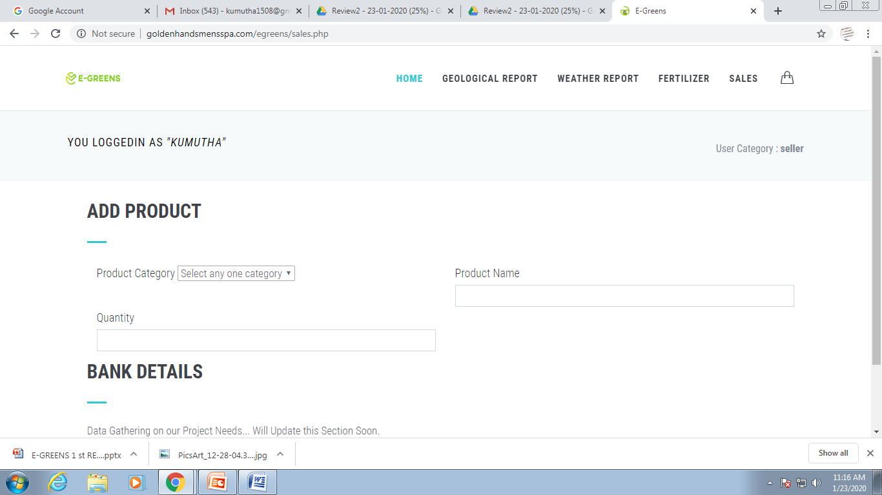
SALES

Slide 25
GEOGRAPHICAL REPORT
In this module farmer can check the quality and characteristics of the soil through that they can get the idea about what they can seed in their land.
Based on the requirements filled the test reports could be framed accordingly.

Slide 26
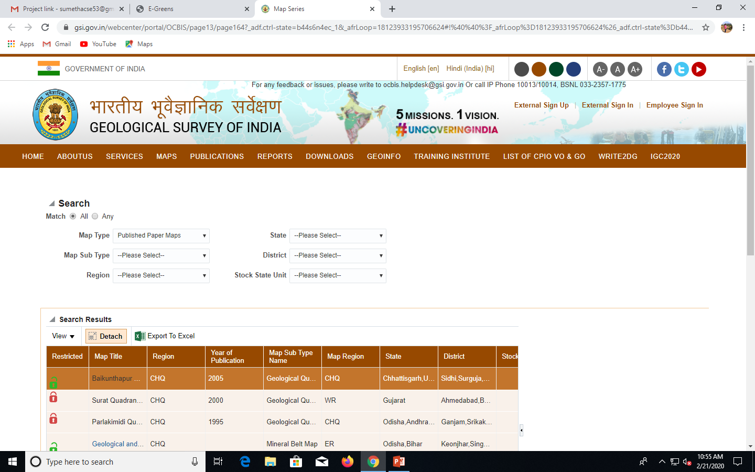
GEOGRAPHICAL REPORT

Slide 27
REFERENCES
Cross-Platform Development for an online Food Delivery Application.
Design and Implementation of an Android Application using Wi-Fi- enabled Devices for the Food Servicing Industry.
Iaetsd Journal for Advanced Research in Applied Sciences.
Integration of Touch Technology in Restaurants using Android.

Slide 28
REFERENCES
Android Application for Local food ordering system.
Implementing Digital Restaurants and Inter- Restaurant Navigation Using Smart Phones.
Smart Restaurant System Using Android.
E-Restaurant: Online Restaurant Management System for Android.

Slide 29

ANY QUERIES?
THANK YOU

